Slide 1
Road Accident Analysis
Data insights & Strategic Recommendations
CONTENTS
Introduction to Road Accidents in Nigeria
Aims and Objectives
Data Collection and Cleaning
Key Findings and Insights
Analysis
Recommendations
Conclusion
Presented by: PHILLIP YETUNDE
Date: 3rd March, 2025

Slide 2
Introduction to Road Accidents in Nigeria
Road traffic accidents in Nigeria are a major public safety concern, contributing to significant loss of lives, injuries and economic costs.
This casualties are largely due to reckless driving, poor road conditions and inadequate enforcements of traffic laws, common causes include over speeding, dangerous driving, use of phone while driving.
The impact of road accidents extends beyond human casualties, affecting the economy through medical costs, property damage and lost productivity

Slide 3
Aims and Objectives
The aim of this analysis is to gain insights from the dataset by addressing the following objectives:
Analyze the number of casualties (minor, serious, fatal, numbers injured, numbers killed) for each quarters
Investigate how different vehicles types contribute to road traffic casualties
Compare the number of male/female casualties to understand any patterns
Determine states with the highest casualties and their causative factors
Assess whether an increase in population affect number of road casualties

Slide 4
Data Collection and Cleaning
The dataset for this analysis was obtained from the National Bureau of Statistics (NBS) Portal and includes data for six quarters:
Q1 2023, Q2 2023, Q3 2023, Q4 2023, Q1 2024, Q2 2024.
Dataset Overview
The dataset consists of the following key information:
Data on minor, serious, fatal crashes, as well as the number of injured, killed and people involved on state basis and casualties.
Male and Female Casualties (both injured and killed) across all six quarters
Details of the different types and categories of vehicles involved in road accidents for each quarters
The main causes of road crashes for each quarters

Slide 5
Data Cleaning and Processing
The dataset was loaded into Power Query in Power BI, where the following cleaning steps were applied:
Null values were removed
Column names were standardized for consistency
Inconsistent decimal values were rounded to two decimal places for accuracy
A custom column titled “Quarters” was created to label each row with its respective quarter (e.g, “Q1 2024”).
To simplify analysis, the following data transformations were performed:
Appending Queries:
The six tables containing state & different casualties were appended
The six tables containing causative factors of casualties were also appended
This allowed for the calculation of fatal, serious, minor casualties as well as the number injured and killed individuals

Slide 6
Vehicles Classifications:
13 types of vehicles were grouped into six categories: Car, Bike, Commercial, Bus, Bicycle and Others.
Four vehicle categories were further grouped into Private and Public classifications
Sex Distribution Simplifications
Casualty data initially split into Male Adult, Male Child, Female Adult and Female Child was grouped into Male and Female for a clearer gender based analysis
External Data Integration
An external dataset containing population data from 2006 to 2016 was introduced. Using historical trends, an estimated 2025 population was determined in excel using data Forecasting and imported into power BI to analyze the relationship between population growth and road casualties.
I visited the FRSC office to verify how severity of accidents were measured.

Slide 7
Key Findings and Insights
Among all the vehicle types, cars recorded the highest number of casualties, indicating their significant role in road accidents.
The top five states with the highest recorded causative factors of road accidents are FCT, Ogun, Nasarawa, Kaduna, and Jigawa
Men account for 81.4% of casualties, while women make up 18.6%, showing that in every 10 accidents, about 8 male casualties are involved
Kano, despite having the highest population of over 15 million, recorded 2,109 casualties, whereas Kaduna with a smaller population of 10 million, recorded over 6,341 casualties, this reveals that population does not affect the rate of accident based on my analysis

Slide 8
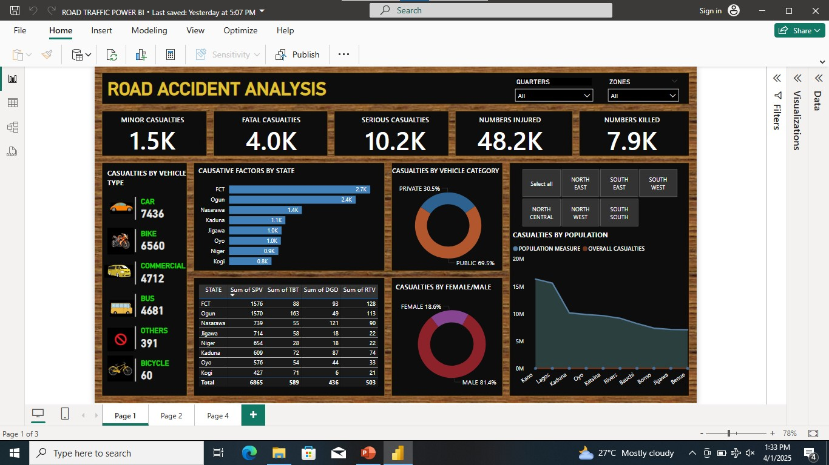
Analysis

Slide 9
Recommendations
Authorities should enforce speed limits, seatbelt use, and penalties for reckless driving, especially in high risk states like FCT, Ogun, Nasarawa, Kaduna and Jigawa
Enhancing road conditions, and traffic management systems in accident prone areas can reduce crashes. Kaduna with its high casualty rate, may require urgent road safety improvement
Since men account for higher percent of casualties, campaigns should focus on promoting safer driving habits among male drivers especially commercial vehicles operators
Use radio, TV, and social media to educate road users on the risks of over-speeding, dangerous driving, and ignoring road signs
Enforce regular tyre inspections, especially for commercial vehicles. Educate drivers on tyre maintenance, the dangers of using expired or substandard tyres and proper inflation to prevent tyre burst
Government should upgrade and maintain road signs, ensuring they are visible and properly placed.

Slide 10
CAUSATIVE FACTORS CODE
CAUSATIVE FACTORS | CODE
Speed Violation (SPV) | SPV
Tyre Burst (TBT) | TBT
Dangerous Driving (DGD) | DGD
Route Violation (RTV) | RTV

Slide 11
Conclusion
Road accidents in Nigeria pose a major safety challenge, with high casualty rates driven by factors like speeding, dangerous driving, and poor vehicle maintenance. Addressing these issues through stronger speed enforcement, regular tyre inspections, public awareness campaigns, and enhanced emergency responses services will be crucial in reducing road casualties
By implementing these recommendations, Nigeria can make its roads safer, minimize accidents and protect lives, contributing to a more secure and efficient transportation system.

